Slide 1

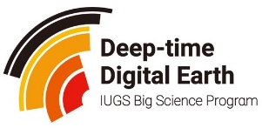
Large Language Models For Map Generation: Nigerian Geoscience
International Geological Congress (IGC) Busan, Korea
Shadrach S. Sheriff & GeoGPT Team, Zhejiang Lab
GIS Analyst
DMW LOVOL Engineering Ltd. Lagos, Nigeria
30th August 2024

Slide 2

OUTLINE
INTRODUCTION
THE NEED FOR AI INTEGRATION
TRADITIONAL MAPPING SOFTWARES
MAP GENERATOR
Foundation and Enhancement
Map Generator – Use Case
Map Generator Application potential
Benefits of the Map Generator
GEOREFERENCING TOOL
OTHER FUNCTIONS - GeoGPT
HOW CAN GeoGPT AND MAP GENERATOR IMPROVE
CONCLUSION

Slide 3

INTRODUCTION
Tobler’s first law of geography
Mineral Exploration, Geophysics, Paleontology, Hydrogeology – Mapping applications.
Mapping skills is required but not all researchers and professionals posses these skills
Reducing the Requirement for Professional Knowledge and Systematic Learning: Traditional geological map generation tools require extensive geological expertise and systematic learning, creating a high barrier for non-professionals or beginners.
Open Science – democratizing resources
Notes:
More than 80% research in geoscience involves the spatial component – The science of where. The First Law of Geography, according to Waldo Tobler, is "everything is related to everything else, but near things are more related than distant things." This first law is the foundation of the fundamental concepts of spatial dependence and spatial autocorrelation
LLM Tool Usage Has Been Successfully Applied in Various Fields to Enhance Efficiency and Accuracy: In finance, LLMs combine data analysis and risk management tools to provide real-time investment advice and risk assessments. In healthcare, they integrate electronic health records and medical literature to help doctors quickly analyze patient information and offer personalized treatment plans.

Slide 4
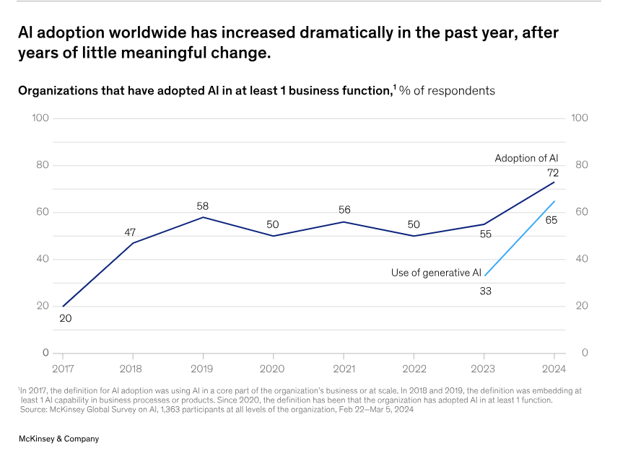
THE NEED FOR AI INTEGRATION
A 2024 McKinsey survey shows that AI adoption has more than doubled over the past five years, and investment in AI is increasing apace.
Enhanced access to geological information – Data consolidation, Historical data utilization
Guiding research – Identifying knowledge gaps, predictive analysis
Cost efficiency
The state of AI in early 2024: Gen AI adoption spikes and starts to generate value
Notes:
McKinsey research indicates that gen AI applications stand to add up to $4.4 trillion to the global economy—annually. Indeed, it seems possible that within the next three years, anything in the technology, media, and telecommunications space not connected to AI will be considered obsolete or ineffective.

Slide 5
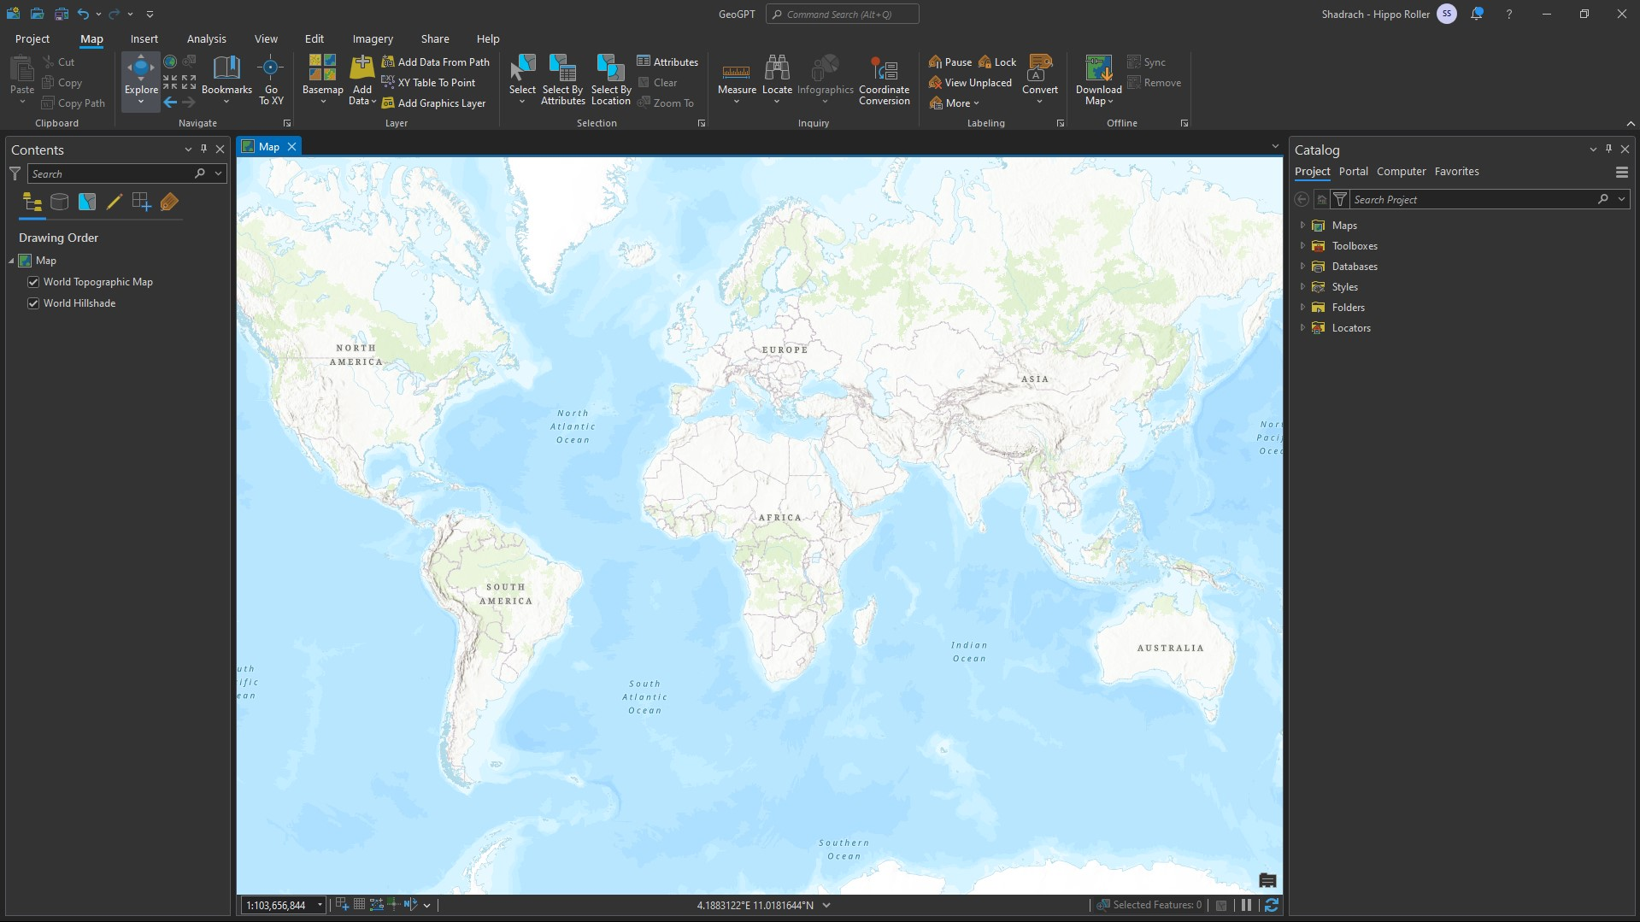
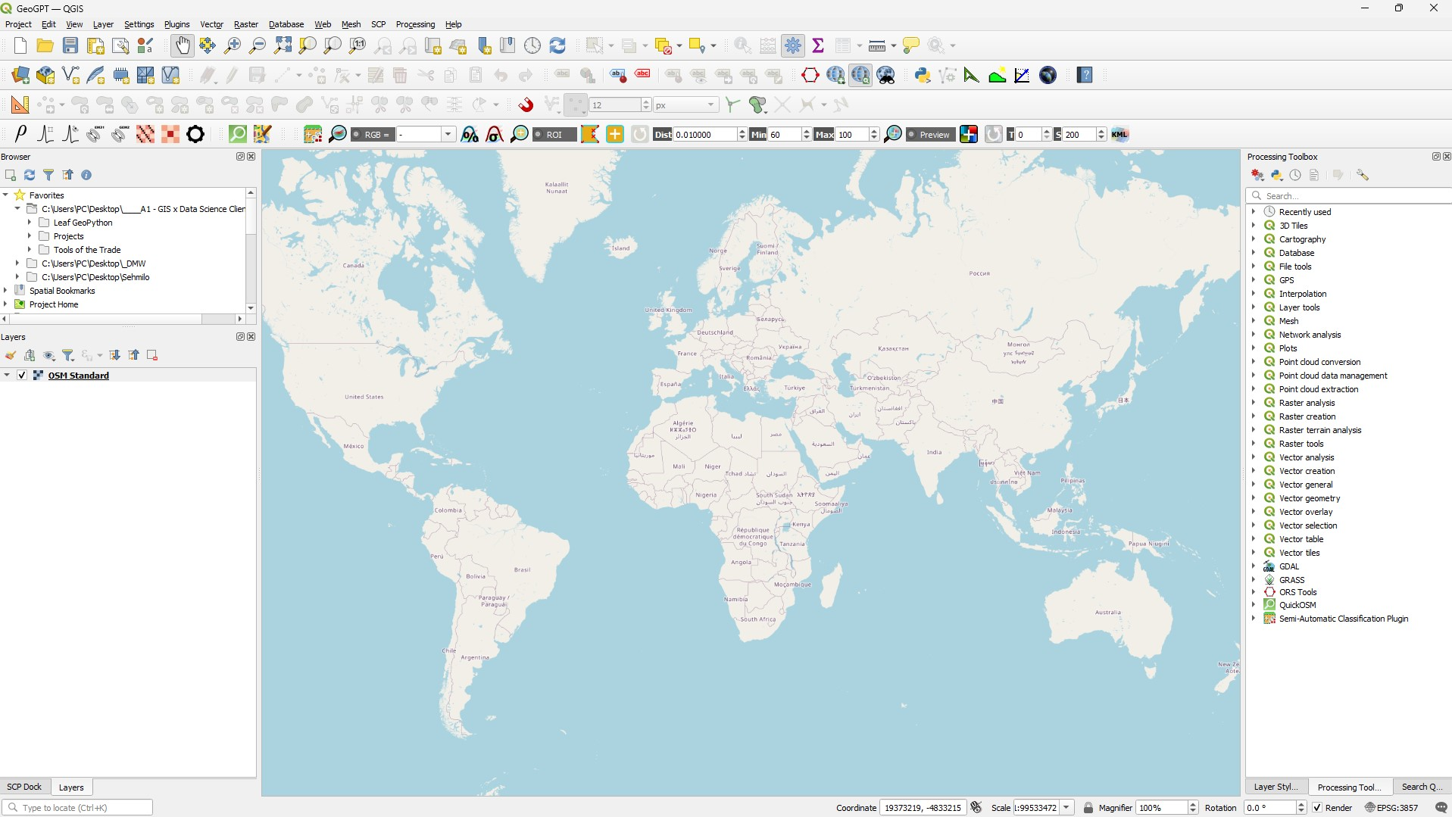
Traditional Mapping Software
Traditional geological map generation tools are cumbersome, involving complex steps and requiring extensive manual operations.
ArcGIS Pro
Steep Learning Curve
High cost (Subscription-Based Model) - $100 (₦158,857.00)
High System Requirements
Complex UI –
Dependency on Esri Ecosystem
QGIS
Open source
Steep Learning Curve
Plugin Dependency
Lack of formal support
Notes:
The average Nigerian student cannot afford a $100 dollar licensed software and more so a high end computer with good system requirements are very expensive which

Slide 6
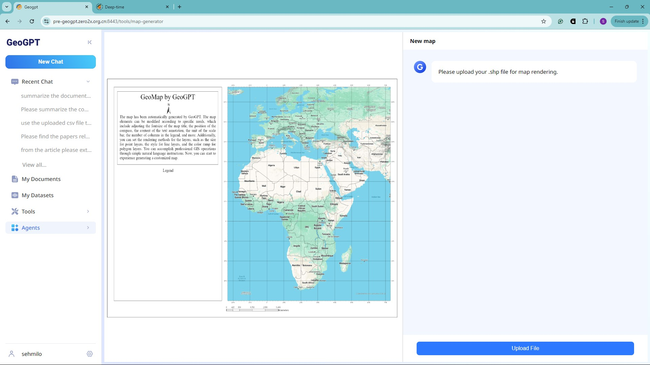
Map Generator
A text-interactive geological map drawing tool based on GeoGPT.
Instant Map Generation
Standardized Layout Template
Flexible Instruction Interface
Intelligent User Understanding
Precise Tool Selection
Notes:
The Map Generator is a geological mapping tool developed with GeoGPT as its underlying model, utilizing the COT method to enhance traditional GIS mapping approaches through text-based interaction. Compared to traditional mapping methods, it features convenience, a low learning curve, and broad applicability.

Slide 7
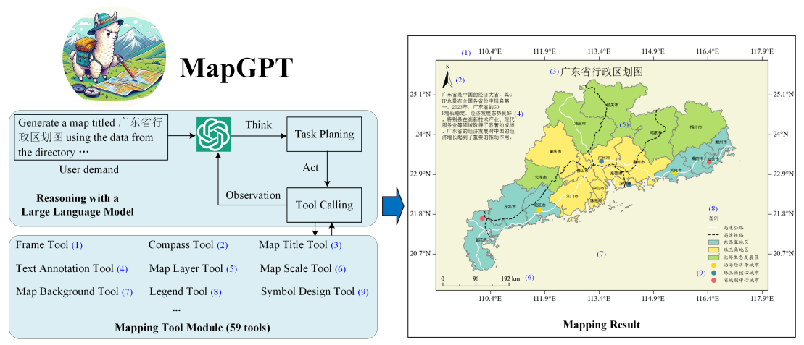
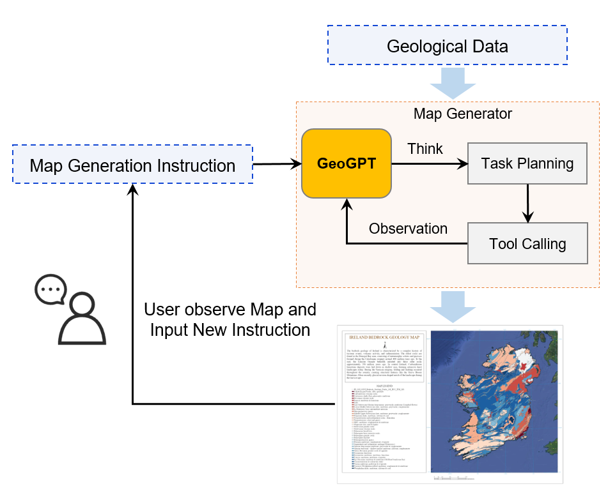
Foundation and Enhancement
Inspired by MapGPT, functional improvements and interaction optimizations were made based on GeoGPT, leading to the development of a geological map creation plugin.
Foundation - MapGPT
Map Generator
Translate map generation instructions into tool invocations using GPT-4 and chain-of-thought reasoning.
LLM: GPT-4
Tools: 59 Tools
Map Initialization
Add Layers
Add Elements
Map Storage
Based on GeoGPT: GeoGPT uses geoscience-specific data for training, making it better suited for map generation and more convenient for providing free public services
Extensive GIS Data Support: supports processing of various file and allows the addition of basemaps
User-Friendly for Non-Professionals: supports natural language instructions with a lower barrier to entry.
More Geological Map-Oriented Tools: more tools tailored for geological map generation will be added by integrating the needs of geoscience experts
Zhengting He, Jingxuan Li, Jianfeng Lin, Qingfeng Guan, Wenhao Yu*.
MapGPT: An Autonomous Framework for Mapping by Integrating Large Language Model and Cartographic Tools. 2024
Notes:
The implementation of Map Generator began by drawing inspiration from the MapGPT team led by Professor Yuwenhao at Wuhan University. Building on their work, the functionality and interaction logic were further expanded, and the tool successfully supports AI-driven automatic mapping using GeoGPT. Currently, the tool and parameter invocation accuracy both exceed 98%.

Slide 8
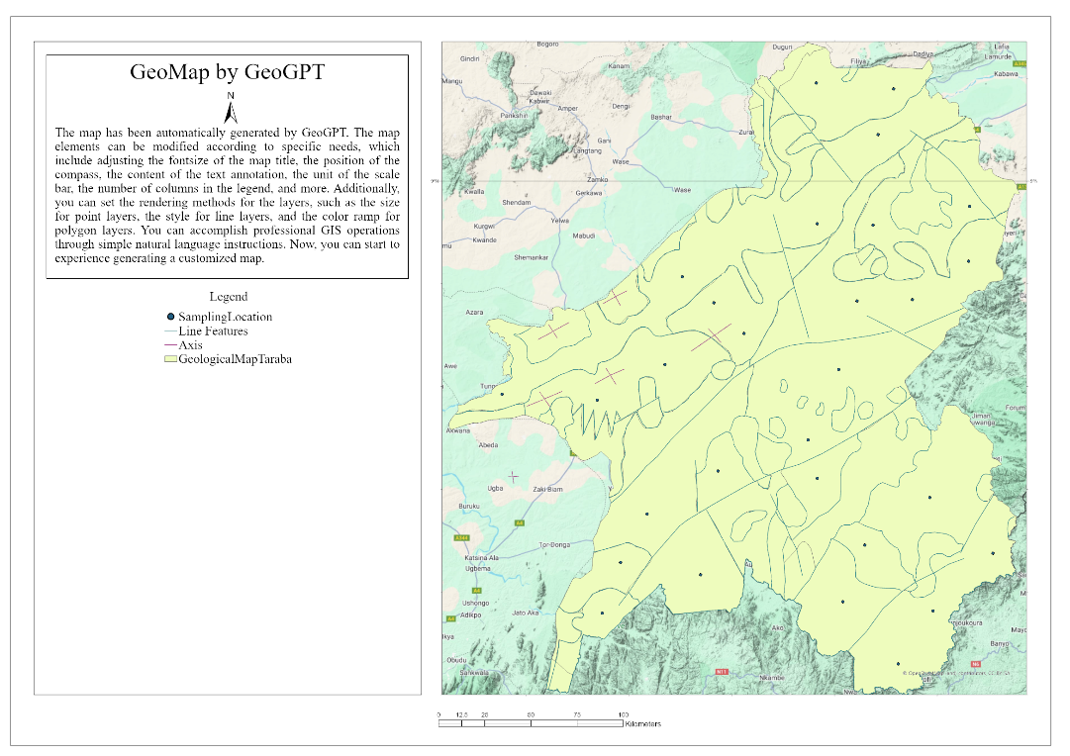
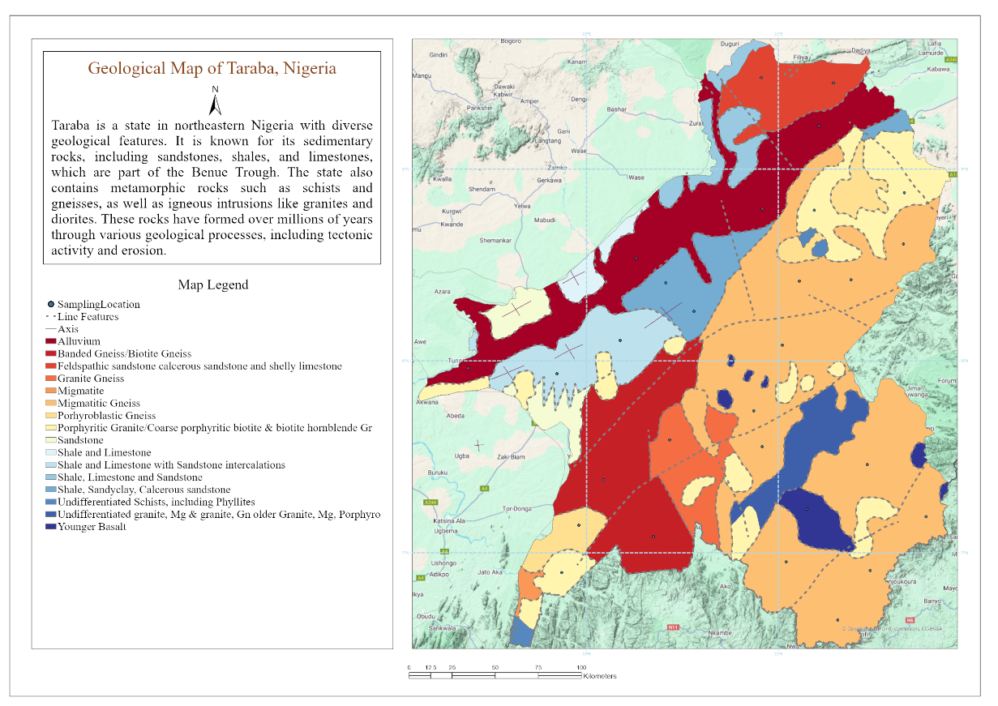
Map Generator – The End Product
Shapefile Uploaded to Map Generator
Geological Map generated in Map Generator

Slide 9
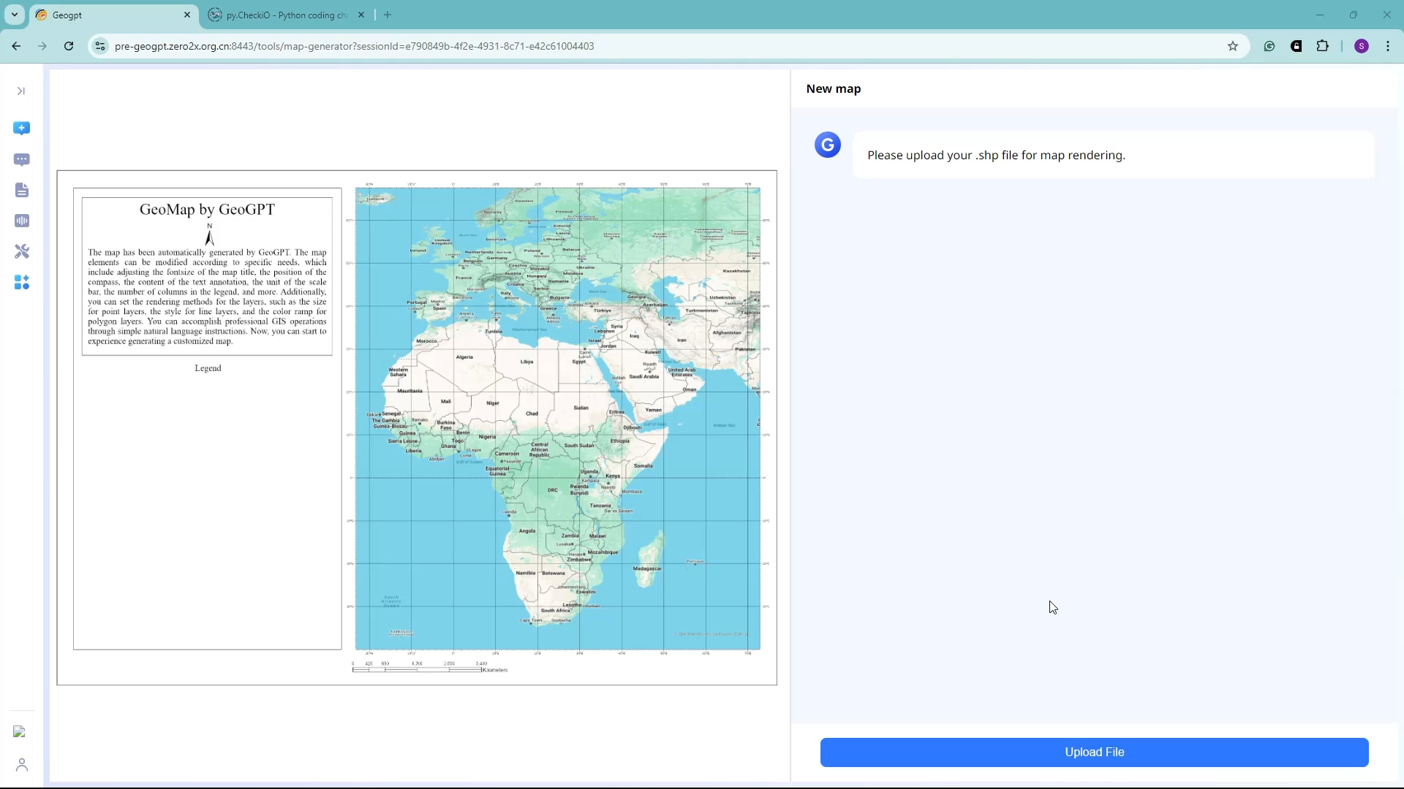
Map Generator: Use Case
Powerful semantic understanding
Natural language commands for quick map creation.
Long text commands for multiple modification units
GenAI capabilities
Notes:
GeoGPTs powerful semantic understanding ability ensures that Map Generator can accurately understand user needs.
It efficiently processes natural language commands to identify and apply appropriate cartographic tools for quick map creation.
Supports the integration of long text commands for multiple modification units
Leveraging GeoGPT’s reasoning and language generation capabilities, an automatic construction of a description about the geology has been created.

Slide 10

Map Generator – Final Output
I want to set the background maps as terrain map
Modify the color ramp of the polygon features based on the NAME field by the selection.
For LineFeatures please set the line width to 3, style as a dashed line and color as grey
For the grid lines set their interval to 1 degrees with a width of 2px and grid style to dash, color is lightblue
Please set the legend title to 'Map Legend' with its font size to 25pt
Please change map title to 'Geological Map of Taraba, Nigeria' with its font size to 30pt, title color is dark brown. Please write a 170 summary of the geology of Taraba, Nigeria and set it as the map's annotation, with font size to 24pt.
Notes:
In 6 prompts we were able to go from an empty looking shapefile to a geological map
GeoGPTs powerful semantic understanding ability ensures that Map Generator can accurately understand user needs.
It efficiently processes natural language commands to identify and apply appropriate cartographic tools for quick map creation.
Supports the integration of long text commands for multiple modification units
Leveraging GeoGPT’s reasoning and language generation capabilities, an automatic construction of a description about the geology has been created.

Slide 11


Map Generator Application Potential
For General Researchers
For Professional Cartographers
No additional cartographic knowledge required; maps can be generated quickly.
Teaching Aid: Supports geography course instruction
Paper Illustrations: Visualizes research areas
Academic Presentations: Displays data distribution
Automatic Initialization: Quickly design map prototypes
Streamlined Operations: Simplify complex workflows and enhance mapping efficiency
Reduced Difficulty: Focus more on core research by lowering mapping complexity
Notes:
The Map Generator serves two main user groups: general researchers and professional cartographers. For general researchers, who often have limited cartographic knowledge, the tool supports the creation of maps for papers, publications, and teaching materials, offering a low learning curve. Professional cartographers, with their extensive mapping experience, can benefit from the tool by automating the "necessary, complex, and redundant" steps in the mapping process, allowing them to focus more on the core aspects of their work.

Slide 12
Benefits of the Map Generator
Free for all.
Cloud Computing and AI: The integration of AI with cloud-based geospatial platforms allows for the scalable processing of maps, making advanced geospatial analysis accessible to more users, from small individuals to large organizations.
User-Friendly Interface: AI-driven tools can simplify complex geospatial analysis, making it more accessible to non-experts through intuitive interfaces and automated insights.
Natural Language Queries: Map generators can create maps based on natural language instructions, making them more user-friendly. Users can describe what they want to see on a map, and the AI can generate it without needing detailed technical input.
Context-Aware Mapping: Map Generator can understand the context behind a query or instruction, allowing for the creation of maps that are tailored to specific needs.

Slide 13
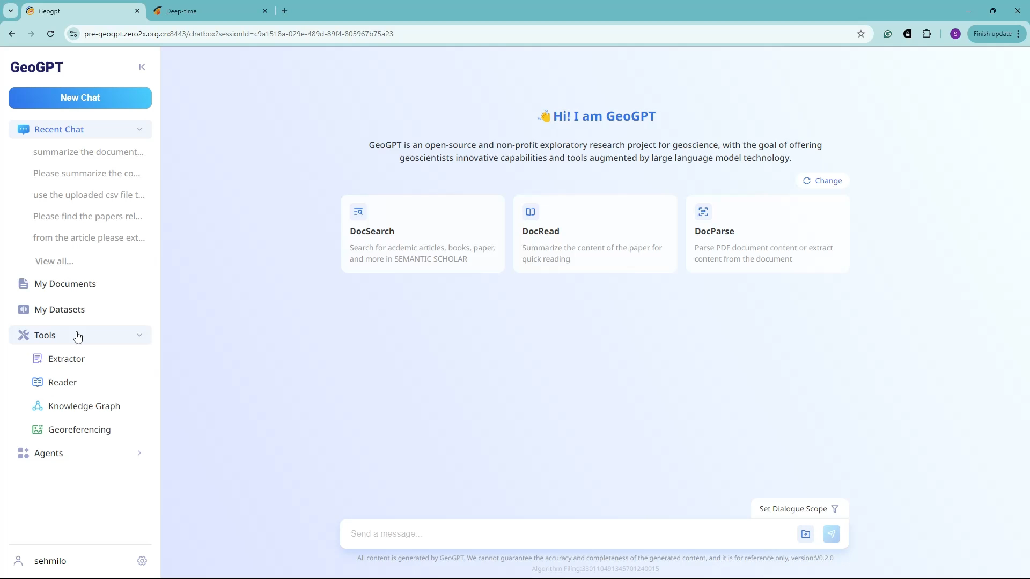
Georeferencing and Point Extraction
Automated Georeferencing
For further field investigation
Precision mapping
Literature review of study area with no prior GIS knowledge
Environmental monitoring - application
Notes:
LLMs can extract specific data points needed for tailored geospatial mapping solutions,

Slide 14
Other Functions - GeoGPT
GeoGPT can automatically extract tabular data from a variety of sources (e.g., PDFs, spreadsheets, web pages) without manual intervention. This automation speeds up the data collection process, especially when dealing with large datasets or multiple sources – enhancing data mining.
Enhanced search and retrieval – personalized interactions
Multi-round conversations – read documents
Describe equations
Gain insights from literature
Notes:
LLMs can automatically extract tabular data from a variety of sources (e.g., PDFs, spreadsheets, web pages) without manual intervention. This automation speeds up the data collection process, especially when dealing with large datasets or multiple sources.

Slide 15

How Can GeoGPt and the Map Generator Improve
Custom solutions with local data integration
Enhanced features analytical features – Measurement, Clipping
Real-Time Learning and Adaptability
Better Handling of Multimodal Data – Raster
Chain of thought prompting, whereby the model is encouraged to “show its work” in solving new problems
More data = Reduced hallucination
Local prompt designers/engineers.
Integrate GeoGPT into DDE
Notes:
To improve GeoGPT, it is essential to focus on enhancing contextual understanding, reasoning capabilities, domain-specific knowledge, and efficiency, while also addressing challenges related to bias, interpretability, adaptability, and security. By advancing in these areas, LLMs can become more powerful, reliable, and applicable across a broader range of tasks and industries.

Slide 16
CONCLUSION
While many have reacted to AI and machine learning with fear, machine learning clearly has the potential for good.
Combining the Map Generator, Georeferencing, and table extraction tool users are able to perform dynamic and contextual mapping without prior knowledge of GIS techniques.
By leveraging cloud computing and machine learning, GeoGPT accelerates innovation and discovery in geosciences, potentially leading to breakthroughs in understanding the earth.
We now know machines can solve simple problems like table extraction and generating maps. But I think we’re poised for even more ambitious capabilities, like solving complex geological problems with LLMs.
To enhance the processing of vast amounts of geoscientific data, there’s the need to integrate LLMs into our workflow within the Nigerian geoscience space.
We have a responsibility to think through what these models will be good for and how to make sure this is an evolution rather than a disruption.
AI, LLMs won’t replace geologist! They’re just tools to augment with preexisting dataset and knowledge.

Slide 17

APPRECIATION
Professor Michael H. Stephenson
Dr. Natarajan Ishwaran
Professor Michael A. Oladunjoye
Professor Olatunji S. Akinade
Professor Olugbenga A. Okunlola

Slide 18

THANK YOU ALL FOR LISTENING
들어주셔서 모두 감사합니다

